Slide 1




Video Games Market Analysis
Data Source : RAWG API
Presented by
05/12/2025
Patole Jeremy

Slide 2



45%
3 billion
$200 billion
Increase in gaming revenue
Active gamers worldwide
Global market value

Slide 3


SUMMARY
Objectives & Pipeline
Data Collection & Data Source
Data Cleaning & Exploration
Hypothesis & Results
Machine Learning
Regression Model
Classification Model
Data Storage
API Exposure
Business Insights & Opportunities
Conclusion

Slide 4


Objective & Pipeline
Working with clean, modular and reusable data
Explore Gaming Market tendencies
Test differents statistical hypothesis
Build Machine Learning Models with relevant features
Propose concrete Business Insights
Data Collection
Cleaning
Fusion
EDA
Hypothesis
FE & ML
Insights

Slide 5

2. Data Cleaning & Exploration
Using RAWG API → 37k+ games → 30k+ after cleaning
49 columns (categorical & numerical)
Data Standardization, cleaning, merging
Understanding the data & prepare it for future steps
Data Collection
Cleaning
Fusion
EDA
Hypothesis
FE & ML

Slide 6
2. Data Cleaning & Exploration
Using RAWG API → 37k+ games → 30k+ after cleaning
49 columns (categorical & numerical)
Data Standardization, cleaning, merging
Understanding the data & prepare it for future steps
Data Collection
Cleaning
Fusion
EDA
Hypothesis
FE & ML

Slide 7
3. Hypothesis Testing
With the following hypothesis, we explore the influence of multiple key indicators (genre, number of platforms, type of content..) on the player engagement (rating, playtime..)
H1.
STEAM
VS.
NON-STEAM
H2.
MONO
VS.
MULTI
PLATFORMS
H3.
GENRE
&
QUALITY
H5.
PLATFORMS
COUNT
INFLUENCE
H6.
SOLOPLAYER
VS.
MUTIPLAYER
PLAYTIME
H4.
ESRB
INFLUENCE
Data Collection
Cleaning
Fusion
EDA
Hypothesis
FE & ML

Slide 8
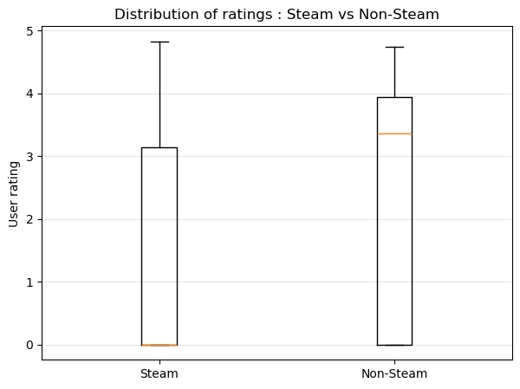
H1. Steam games has higher rating on average than non-Steam games
Statistical Formulation :
- H0 : There is no significative difference in user rating on average between Steam games and non-Steam games
- H1 : Steam games has a different rating than non-Steam games
Statistical Test :
We can perform an independant t-test, because the two groups are independant and this is a continuous variable
→ Reject H0
→ The ratings are significantly different

Slide 9
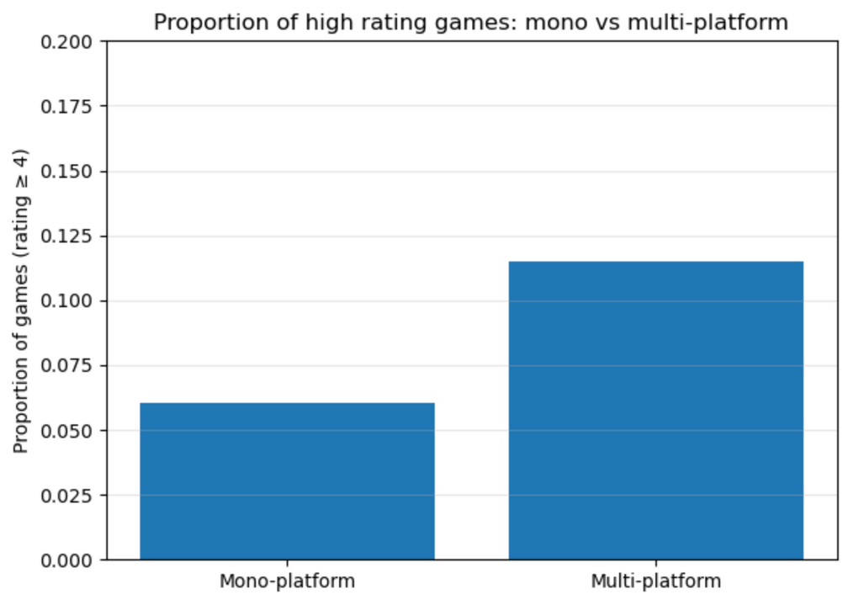
H2. The proportion of high rating is higher for multi-platform games than for mono-platform
Statistical Formulation :
- H0 : There is no significative difference in proportion of high rating games (≥ 4) between multi and mono platforms games
- H1 : The proportion of high rating games is different between the two groups
Statistical Test :
We can perform a proportion z-test because there is two proportions
→ Reject H0
→ The proportions are significantly different

Slide 10
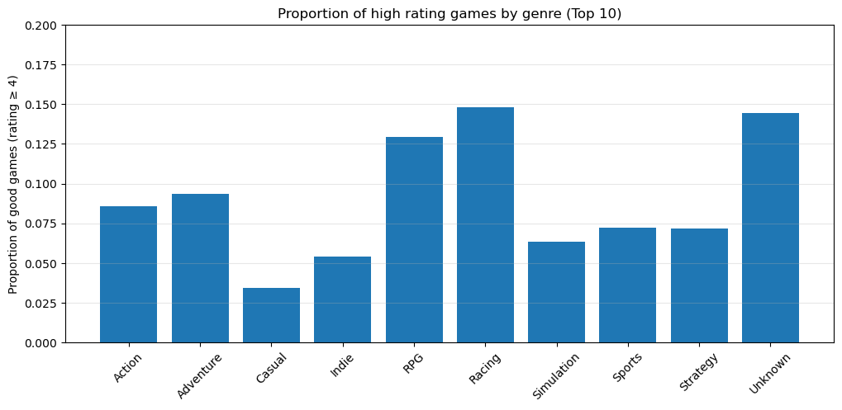
H3. There is a difference in genre distribution based on User rating
Statistical Formulation :
- H0 : There is no correlation between game genre and user rating
- H1 : Game genre and the probability of a high rating game are related
Statistical Test :
We can perform here an independance chi-square test
→ Reject H0
→ There is a correlation between game genre and high rating probability

Slide 11
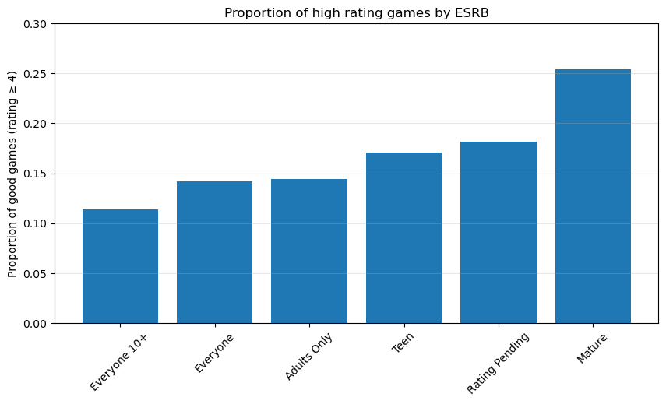
H4. ESRB Rating has an influence on high rating probability
Statistical Formulation :
- H0 : There is no correlation between ESRB rating and user rating
- H1 : ESRB rating and high rating probability are related
Statistical Test :
We can perform an chi-square test
→ Reject H0
→ There is a correlation between ESRB rating and high rating probability

Slide 12
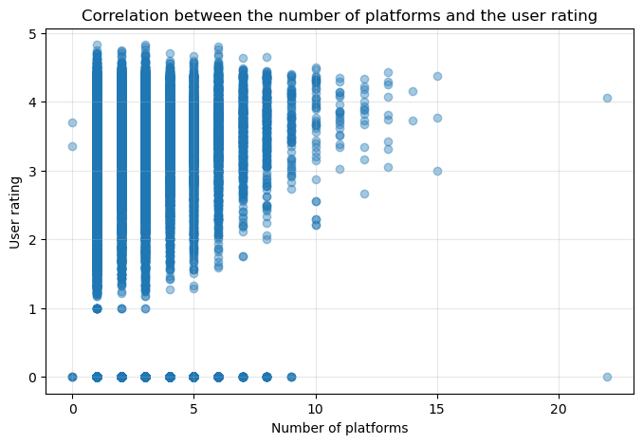
H5. The number of platforms and the rating are correlated
Statistical Formulation :
- H0 : There is no correlation between the number of platform and the user rating
- H1 : There is no correlation between the number of platform and the user rating (positive or negative)
Statistical Test :
We can run a Spearman correlation test
→ Reject H0
→ There is a correlation between the number of platform and the user rating

Slide 13
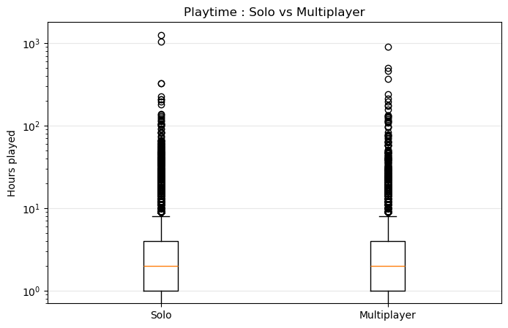
H6. Users are more engaged on Multiplayer games
Statistical Formulation :
- H0 : There is no difference in playtime distribution on average between multiplayer games and other games
- H1 : There is a difference in distributions (users playtime on multiplayer games are higher)
Statistical Test :
We can run a Mann–Whitney test
→ Reject H0
→ There is a difference in playtime between multiplayer and non-multiplayer games

Slide 14
Feature Engineeering
Simplify several columns by extracting meaningful numerical features : release dates → release years
positive vs. negative reviews
Create new behavioral indicators : engagement index
Encoded categorical variables : one-hot encoding for the rating category
several flag dataframes
Remove columns that were too textual or too sparse to be useful

Slide 15
4. Machine Learning
a. Regression Model Performance
Gradient Boosting
Random Forest
MAE : 0.1629
RMSE : 0.3008
R² : 0.9694
MAE : 0.1555
RMSE : 0.2962
R² : 0.9703
Based on the evaluations of the different models, we can compare their performance using MAE, RMSE, and R² metrics
This will help us determine which model is best suited for predicting user ratings based on the features we have engineered from the RAWG dataset

Slide 16
4. Machine Learning
a. Regression Model Performance
CatBoost Regressor
LGBM Regressor
MAE : 0.1602
RMSE : 0.2949
R² : 0.9706
MAE : 0.1564
RMSE : 0.2934
R² : 0.9709
We can see that LightGBM has the best performance among the tested models, with the lowest MAE and RMSE, and the highest R² score
This suggests that LightGBM is particularly effective at capturing the relationships in our dataset for predicting user ratings

Slide 17
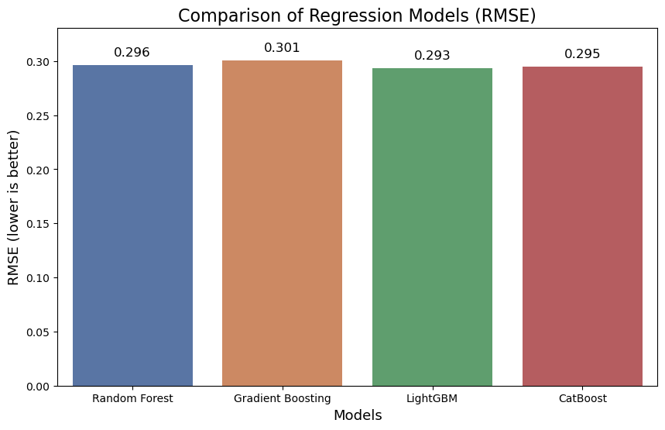
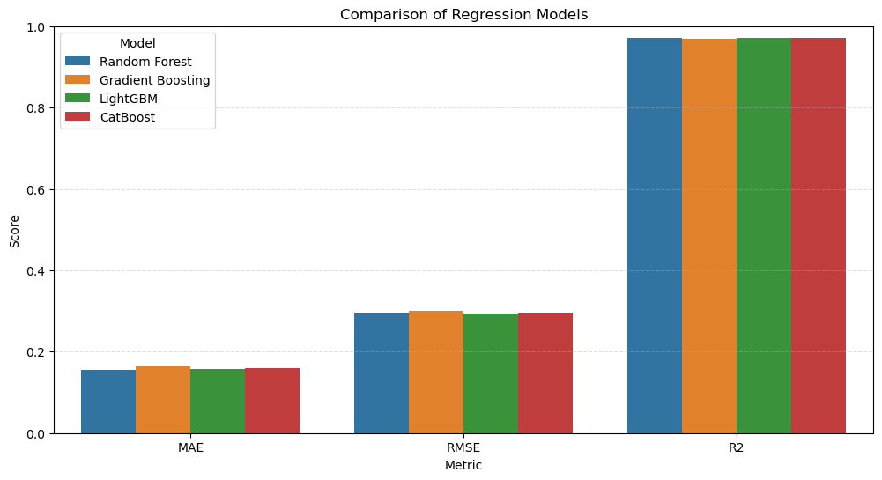
4. Machine Learning
a. Regression Model Performance

Slide 18
4. Machine Learning
b. Classification Model Performance
Random Forest
Gradient Boosting
Accuracy : 0.9349
F1-Score : 0.5419
Recall : 0.4298
Precision : 0.7332
Accuracy : 0.9339
F1-Score : 0.5401
Recall : 0.4327
Precision : 0.7184
ROC-AUC: 0.95388
ROC-AUC: 0.9537
Based on the evaluations, we can compare the performance of the different models and choose the best one for deployment or further tuning

Slide 19
4. Machine Learning
b. Classification Model Performance
Logistic Regression
Accuracy : 0.9250
F1-Score : 0.4381
Recall : 0.3260
Precision : 0.6677
ROC-AUC: 0.90848
This suggests that the model has a good ability to distinguish between high rating and low rating games based on the features provided
We can further tune the hyperparameters of this model or explore ensemble methods to potentially improve performance even more

Slide 20
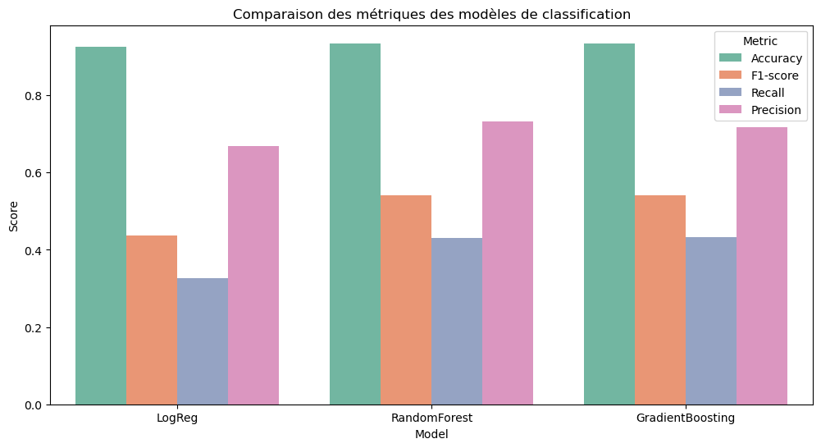
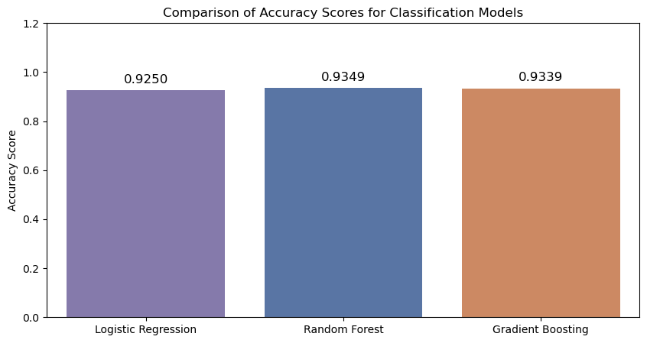
4. Machine Learning
b. Classification Model Performance

Slide 21
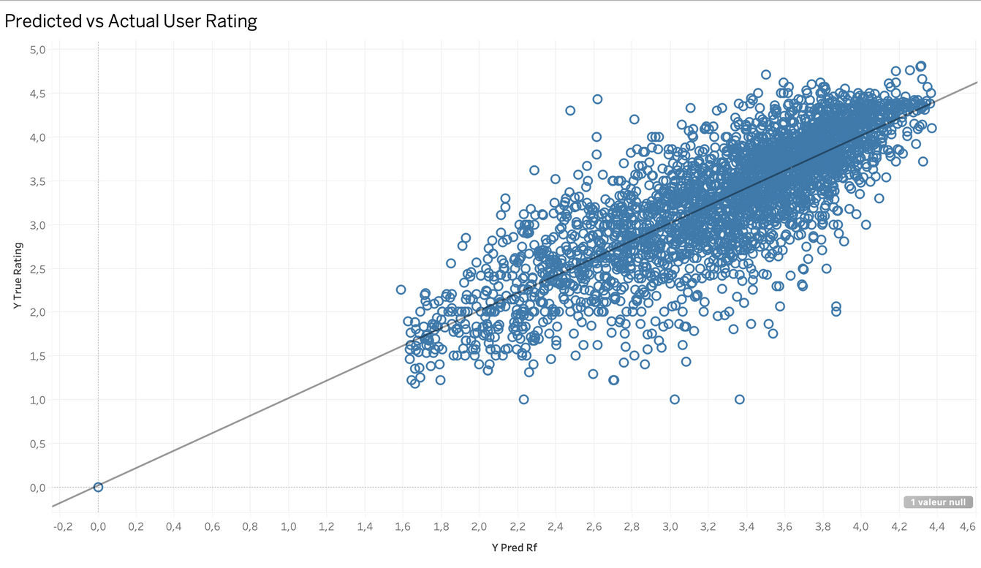
Predictive vs. Actual User Rating
Random Forest Regression Model
Interpretation
Points close to the line y=x → good predictions
Gaps → prediction errors
As we can see here, beside some outliers, the great majority of points are around the trend line

Slide 22
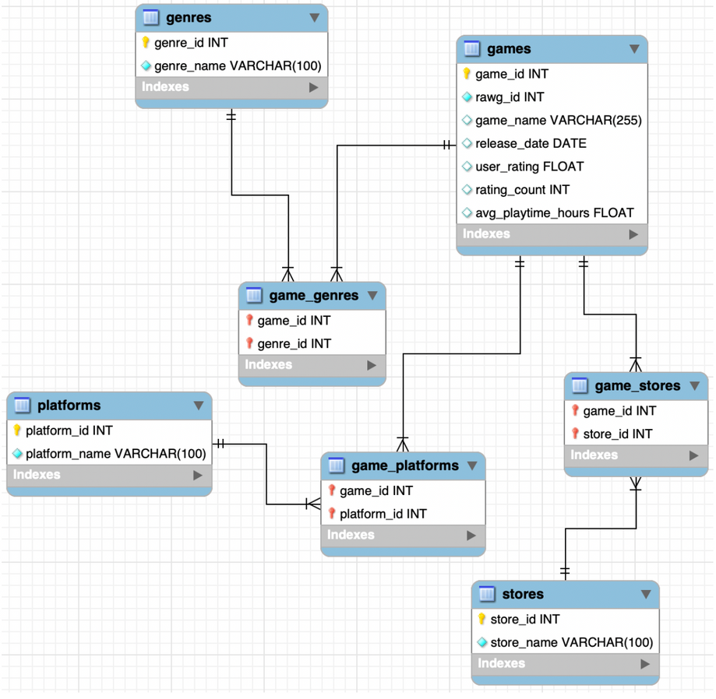
6. Data Storage
Dataset Normalization & ERD
Importation from Python using SQLalchemy to avoid the MySQL Workbench import wizard to avoid common CSV import issues
All 30k+ data from final clean dataframe stored in a vdeo_game_market database
SQL queries to extract insights
More than four entities and three relationships on the ER-Diagram

Slide 23
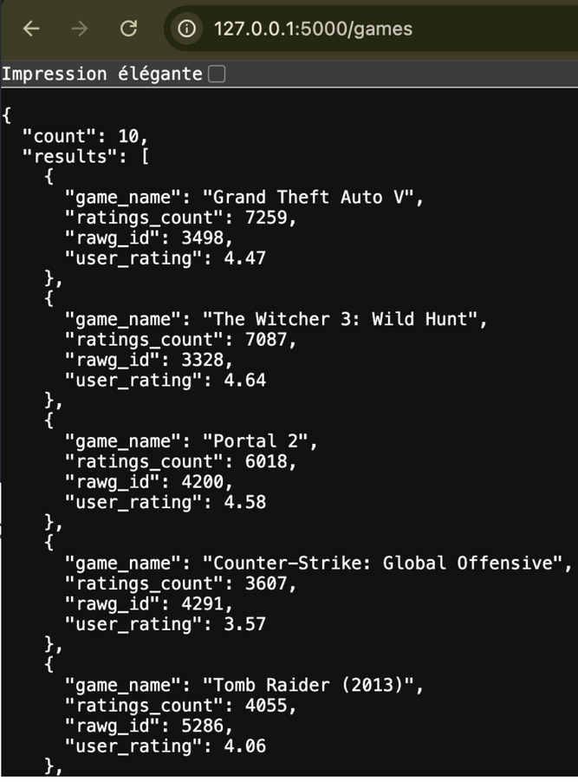
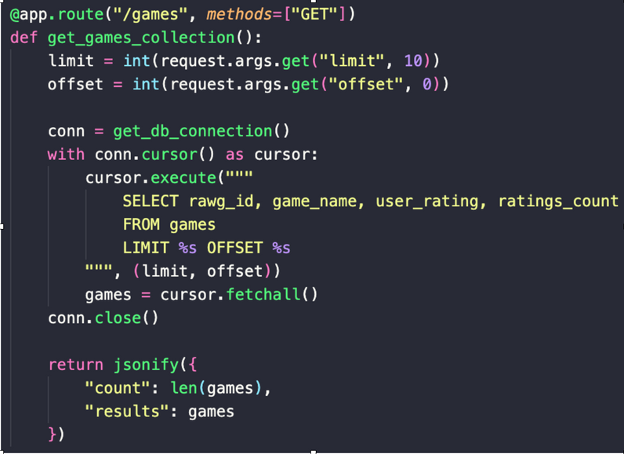
7. API Exposure
API Building
API built using Flask and the video_game_market database
A collection endpoint with pagination
A single-resource endpoint by RAWG ID

Slide 24
8. Business Insights
(SOME OF THOSE CAN EVOLVE WITH FURTHER ANALYSIS)
Tendancies in the game industry
Market Growth Prediction
(based on this sample)
✔ Support market positioning by identifying the most relevant genre and platform
✔ Guide production decisions by highlighting high-impact features such as multiplayer
✔ Enable better marketing performance forecasting prior to release
✔ Multiplayer generate more playtime on average
✔ Genre influence significativly quality perception
✔ Engagment metrics are good indicators of market analysis
Overall, these findings contribute to more informed portfolio optimization for publishers and game studios.

Slide 25

Oportunities
The video game market offer tremendous possibilities to inovate, we see it with new technologies like virtual reality.
Developers can create unique imersive experiences to attract a large public, and transform players interaction with games.

Slide 26

9. Conclusion
We built a solid end-to-end pipeline
Validated statistically meaningful relationships
Created predictive models for game rating and rating category
Extracted actionable insights for industry decision-makers

Slide 27

THANK YOU - Q & A
Data Analysis Project
Video Game Market
Data Source
RAWG API (800,000 + data)
Presented by
Jeremy Patole

